Slide 1

Life on a Budget: Reproduction-growth Trade-Offs in Masting Trees
Xiaomao Wang
Oct 21 2025

Slide 2




Masting
Notes:
Masting as a reproductive strategy featured with high variability in reproduction across years. A common question can be asked is that why tree developed such a reproductive strategy instead of producing same amount of seed every single year. We are all familiar with the predator satiation hypothesis, knowing that the big crop might maximize the seedling survival. However, another characteristics is that a big crop is followed by years of no crop or light crop, so we would wonder if there’s a trade-off between the growth and reproduction causing this pattern in masting.
Plants have limited resources and must actively allocate them to support survival and reproduction. How they allocate their resources is influenced by environmental factors and the plant’s life history strategy. Trade-offs are important for plant fitness because plants cannot maximize all aspects of their life processes with limited resources. Masting as a special reproductive event involving the production of lots of seeds in certain yar, it is intuitive to expect a growth-reproduction trade-off, with the growth of plants during masting years might be impacted. This relationship might be even more complex for conifer species, whose reproductive cycles typically last for two years. In this chapter, I will combine growth data, seed trap data and climate data to explore the relationship between masting and plant growth.

Slide 3

Resources allocation
Defence
Growth
Reproduction
Storage
Notes:
Masting as a reproductive strategy featured with high variability in reproduction across years. A common question can be asked is that why tree developed such a reproductive strategy instead of producing same amount of seed every single year. We are all familiar with the predator satiation hypothesis, knowing that the big crop might maximize the seedling survival. However, another characteristics is that a big crop is followed by years of no crop or light crop, so we would wonder if there’s a trade-off between the growth and reproduction causing this pattern in masting.
Plants have limited resources and must actively allocate them to support survival and reproduction. How they allocate their resources is influenced by environmental factors and the plant’s life history strategy. Trade-offs are important for plant fitness because plants cannot maximize all aspects of their life processes with limited resources. Masting as a special reproductive event involving the production of lots of seeds in certain yar, it is intuitive to expect a growth-reproduction trade-off, with the growth of plants during masting years might be impacted. This relationship might be even more complex for conifer species, whose reproductive cycles typically last for two years. In this chapter, I will combine growth data, seed trap data and climate data to explore the relationship between masting and plant growth.

Slide 4
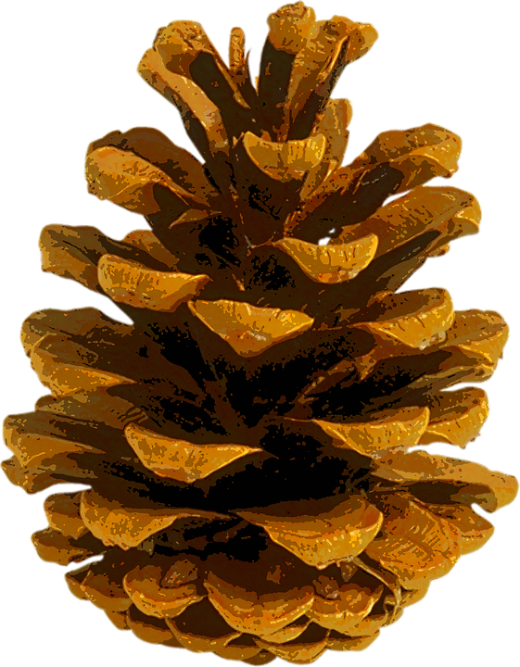
Resources allocation
+
Growth
+
Reproduction
Notes:
Masting as a reproductive strategy featured with high variability in reproduction across years. A common question can be asked is that why tree developed such a reproductive strategy instead of producing same amount of seed every single year. We are all familiar with the predator satiation hypothesis, knowing that the big crop might maximize the seedling survival. However, another characteristics is that a big crop is followed by years of no crop or light crop, so we would wonder if there’s a trade-off between the growth and reproduction causing this pattern in masting.
Plants have limited resources and must actively allocate them to support survival and reproduction. How they allocate their resources is influenced by environmental factors and the plant’s life history strategy. Trade-offs are important for plant fitness because plants cannot maximize all aspects of their life processes with limited resources. Masting as a special reproductive event involving the production of lots of seeds in certain yar, it is intuitive to expect a growth-reproduction trade-off, with the growth of plants during masting years might be impacted. This relationship might be even more complex for conifer species, whose reproductive cycles typically last for two years. In this chapter, I will combine growth data, seed trap data and climate data to explore the relationship between masting and plant growth.

Slide 5
Resources allocation
++
Growth
++
Reproduction
Notes:
Masting as a reproductive strategy featured with high variability in reproduction across years. A common question can be asked is that why tree developed such a reproductive strategy instead of producing same amount of seed every single year. We are all familiar with the predator satiation hypothesis, knowing that the big crop might maximize the seedling survival. However, another characteristics is that a big crop is followed by years of no crop or light crop, so we would wonder if there’s a trade-off between the growth and reproduction causing this pattern in masting.
Plants have limited resources and must actively allocate them to support survival and reproduction. How they allocate their resources is influenced by environmental factors and the plant’s life history strategy. Trade-offs are important for plant fitness because plants cannot maximize all aspects of their life processes with limited resources. Masting as a special reproductive event involving the production of lots of seeds in certain yar, it is intuitive to expect a growth-reproduction trade-off, with the growth of plants during masting years might be impacted. This relationship might be even more complex for conifer species, whose reproductive cycles typically last for two years. In this chapter, I will combine growth data, seed trap data and climate data to explore the relationship between masting and plant growth.

Slide 6
Growth-reproduction trade-off
+
Growth
++
Reproduction
Notes:
Masting as a reproductive strategy featured with high variability in reproduction across years. A common question can be asked is that why tree developed such a reproductive strategy instead of producing same amount of seed every single year. We are all familiar with the predator satiation hypothesis, knowing that the big crop might maximize the seedling survival. However, another characteristics is that a big crop is followed by years of no crop or light crop, so we would wonder if there’s a trade-off between the growth and reproduction causing this pattern in masting.
Plants have limited resources and must actively allocate them to support survival and reproduction. How they allocate their resources is influenced by environmental factors and the plant’s life history strategy. Trade-offs are important for plant fitness because plants cannot maximize all aspects of their life processes with limited resources. Masting as a special reproductive event involving the production of lots of seeds in certain yar, it is intuitive to expect a growth-reproduction trade-off, with the growth of plants during masting years might be impacted. This relationship might be even more complex for conifer species, whose reproductive cycles typically last for two years. In this chapter, I will combine growth data, seed trap data and climate data to explore the relationship between masting and plant growth.

Slide 7
Growth-reproduction trade-off
Growth
++
+
Reproduction
Notes:
Masting as a reproductive strategy featured with high variability in reproduction across years. A common question can be asked is that why tree developed such a reproductive strategy instead of producing same amount of seed every single year. We are all familiar with the predator satiation hypothesis, knowing that the big crop might maximize the seedling survival. However, another characteristics is that a big crop is followed by years of no crop or light crop, so we would wonder if there’s a trade-off between the growth and reproduction causing this pattern in masting.
Plants have limited resources and must actively allocate them to support survival and reproduction. How they allocate their resources is influenced by environmental factors and the plant’s life history strategy. Trade-offs are important for plant fitness because plants cannot maximize all aspects of their life processes with limited resources. Masting as a special reproductive event involving the production of lots of seeds in certain yar, it is intuitive to expect a growth-reproduction trade-off, with the growth of plants during masting years might be impacted. This relationship might be even more complex for conifer species, whose reproductive cycles typically last for two years. In this chapter, I will combine growth data, seed trap data and climate data to explore the relationship between masting and plant growth.

Slide 8





General reproductive cycle
Reproductive organs development
Pollination
Fertilization
Maturation
Dispersal
Notes:
Masting as a reproductive strategy featured with high variability in reproduction across years. A common question can be asked is that why tree developed such a reproductive strategy instead of producing same amount of seed every single year. We are all familiar with the predator satiation hypothesis, knowing that the big crop might maximize the seedling survival. However, another characteristics is that a big crop is followed by years of no crop or light crop, so we would wonder if there’s a trade-off between the growth and reproduction causing this pattern in masting.
Plants have limited resources and must actively allocate them to support survival and reproduction. How they allocate their resources is influenced by environmental factors and the plant’s life history strategy. Trade-offs are important for plant fitness because plants cannot maximize all aspects of their life processes with limited resources. Masting as a special reproductive event involving the production of lots of seeds in certain yar, it is intuitive to expect a growth-reproduction trade-off, with the growth of plants during masting years might be impacted. This relationship might be even more complex for conifer species, whose reproductive cycles typically last for two years. In this chapter, I will combine growth data, seed trap data and climate data to explore the relationship between masting and plant growth.

Slide 9

Growth-reproduction trade-off
‘Positive’ environmental events (environmental cue)
‘Negative’ environmental events (environmental vetos)
More seed (masting)
More growth (non-masting)
Trade-offs help to maximize plants’ fitness when resources are limited
Notes:
Masting as a reproductive strategy featured with high variability in reproduction across years. A common question can be asked is that why tree developed such a reproductive strategy instead of producing same amount of seed every single year. We are all familiar with the predator satiation hypothesis, knowing that the big crop might maximize the seedling survival. However, another characteristics is that a big crop is followed by years of no crop or light crop, so we would wonder if there’s a trade-off between the growth and reproduction causing this pattern in masting.
Plants have limited resources and must actively allocate them to support survival and reproduction. How they allocate their resources is influenced by environmental factors and the plant’s life history strategy. Trade-offs are important for plant fitness because plants cannot maximize all aspects of their life processes with limited resources. Masting as a special reproductive event involving the production of lots of seeds in certain yar, it is intuitive to expect a growth-reproduction trade-off, with the growth of plants during masting years might be impacted. This relationship might be even more complex for conifer species, whose reproductive cycles typically last for two years. In this chapter, I will combine growth data, seed trap data and climate data to explore the relationship between masting and plant growth.

Slide 10
Climate change
Changes of environmental cues
Disruption of synchrony
Uncertainties of resources allocation
Notes:
There are some studies investigating the trade-off between reproduction and growth regarding masting years, and people have different conclusions.
There were trade-offs between acorn production and stem growth in individuals of Quercus ilex. There were negative correlations between acorn production and annual and late summer–autumn stem growth during masting years, but no relationship between acorn production and winter–spring growth.

Slide 11
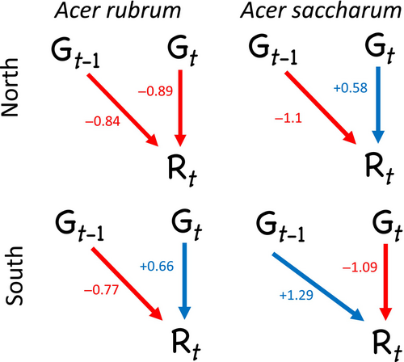
Previous studies
40% no trade-off; 40% trade-off; 20% climate dependent
Climate is very critical, the reproductive cycle is important
Vincent, C., & Ibáñez, I., Ecosphere, 2024
Notes:
There are some studies investigating the trade-off between reproduction and growth regarding masting years, and people have different conclusions.
There were trade-offs between acorn production and stem growth in individuals of Quercus ilex. There were negative correlations between acorn production and annual and late summer–autumn stem growth during masting years, but no relationship between acorn production and winter–spring growth.

Slide 12
Species with different reproductive cycles
Different elevation indicating different resources availability, proxy of climate change
Test on trade-off between the growth in the previous years, current year, following year of the masting years

Slide 13
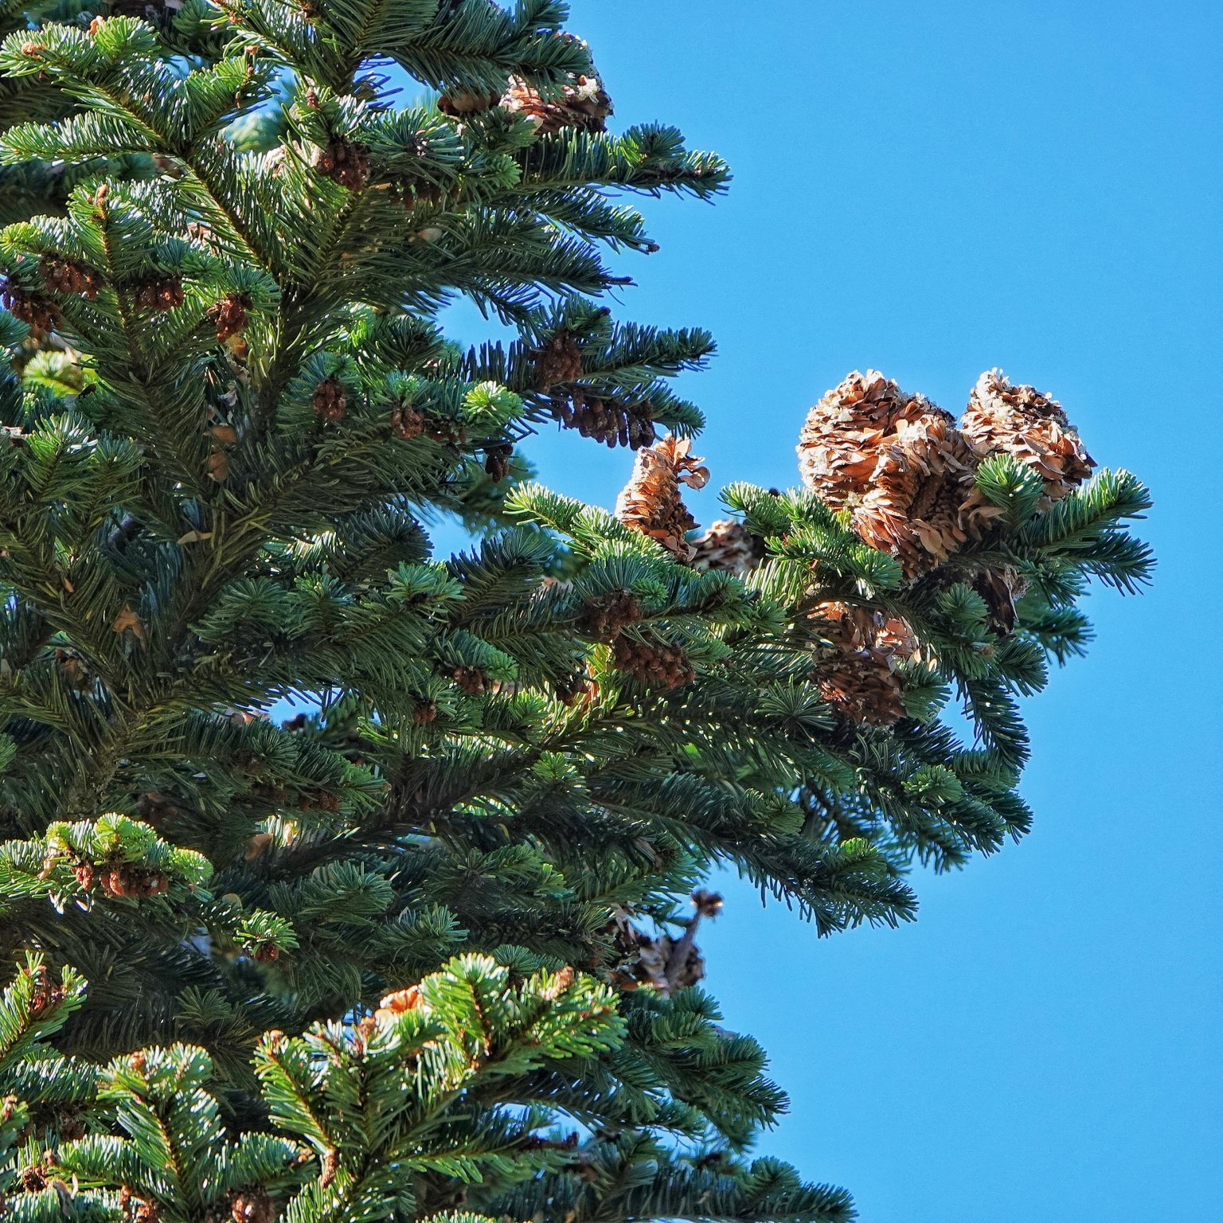
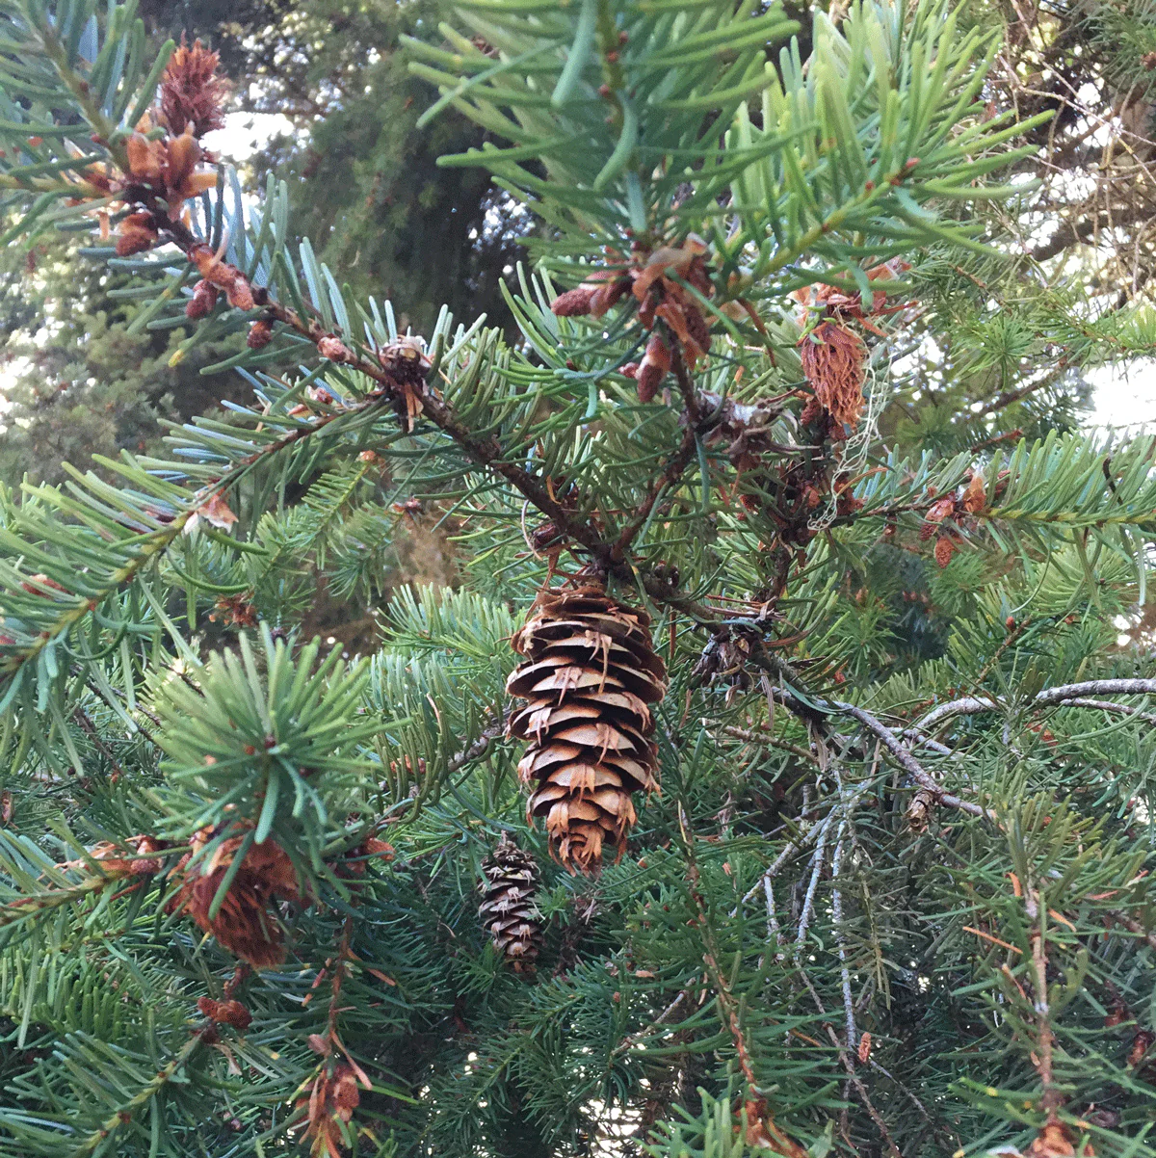
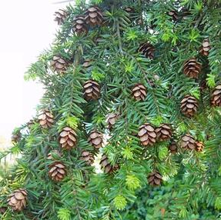
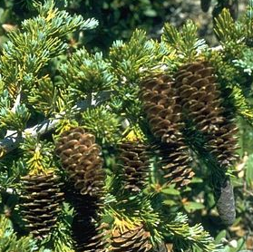
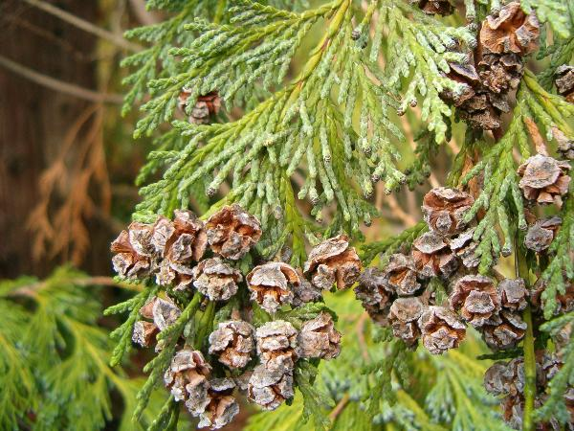
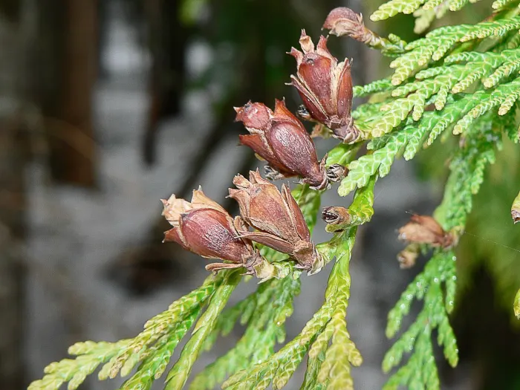
Source: iNaturalist
‘Flower’
development
Pollination
Fertilization
Maturation
Dispersal
Abies amabilis
Pacific silver fir
Fall
Winter
Spring
Summer
Fall
Winter
Spring
Summer
Fall
Pseudotsuga menziesii
Douglas-fir
Fall
Winter
Spring
Summer
Fall
Winter
Spring
Summer
Fall
Tsuga heterophylla
Western hemlock
Fall
Winter
Spring
Summer
Fall
Winter
Spring
Summer
Fall
Tsuga mertensiana
Mountain hemlock
Fall
Winter
Spring
Summer
Fall
Winter
Spring
Summer
Fall
Callitropsis nootkatensis
Yellow cedar
Fall
Winter
Spring
Summer
Fall
Winter
Spring
Summer
Fall
Thuja plicata
Western Redcedar
Fall
Winter
Spring
Summer
Fall
Winter
Spring
Summer
Fall

Slide 14
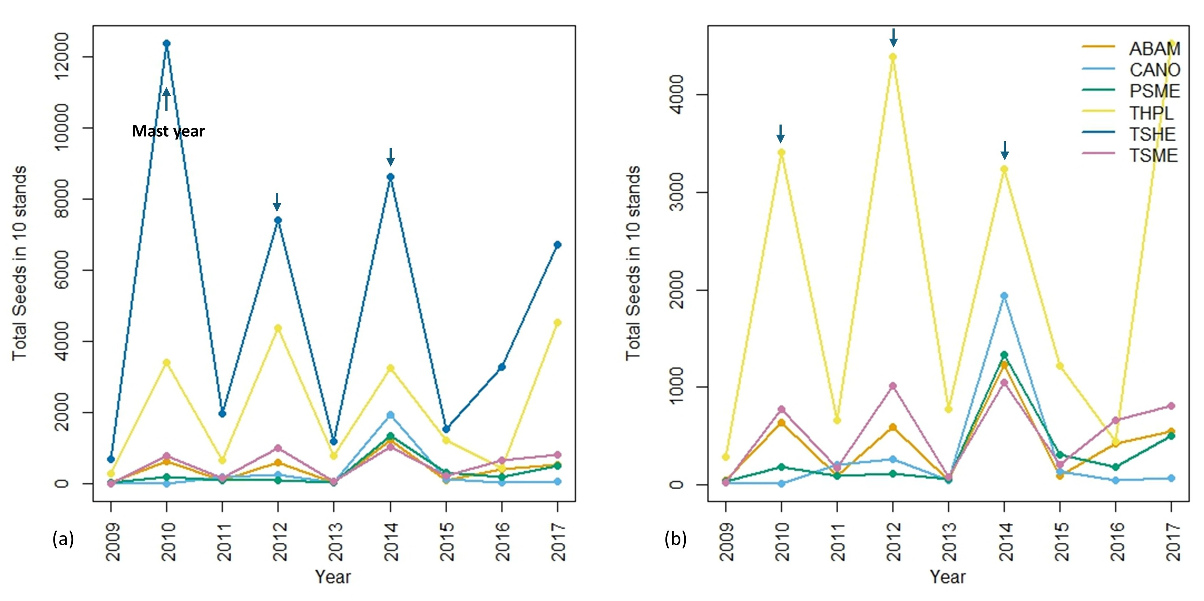
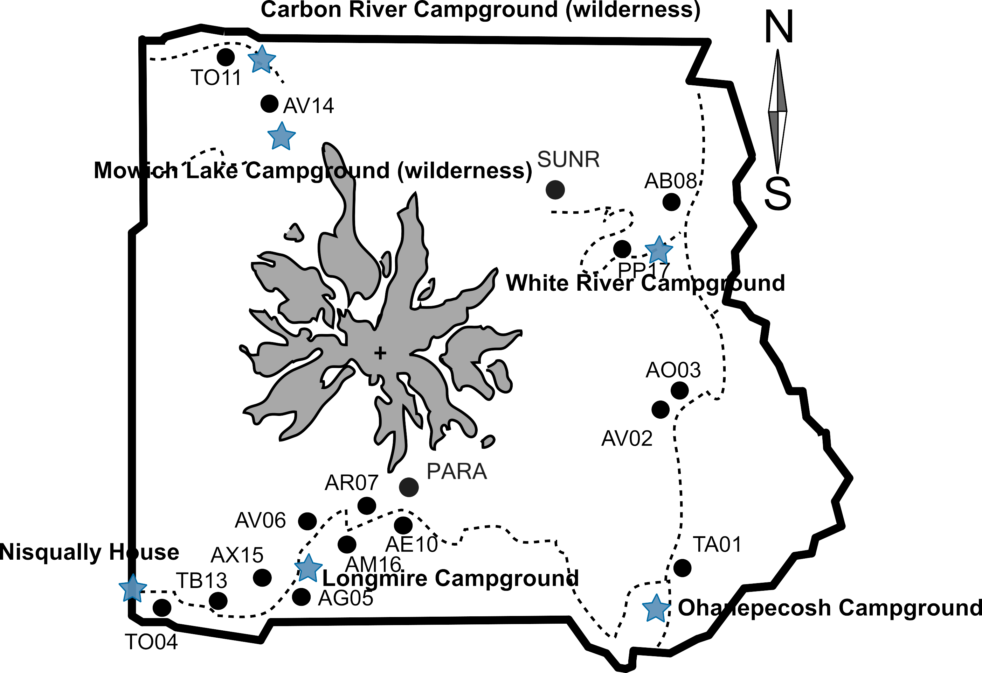
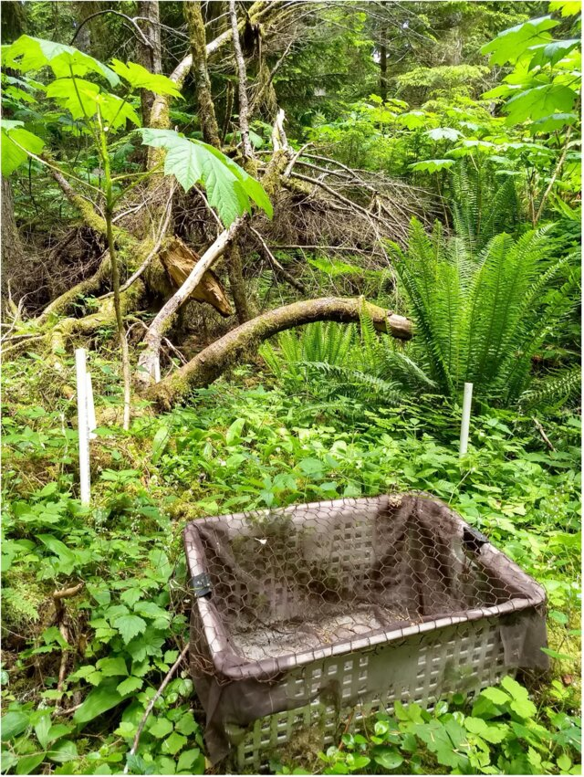
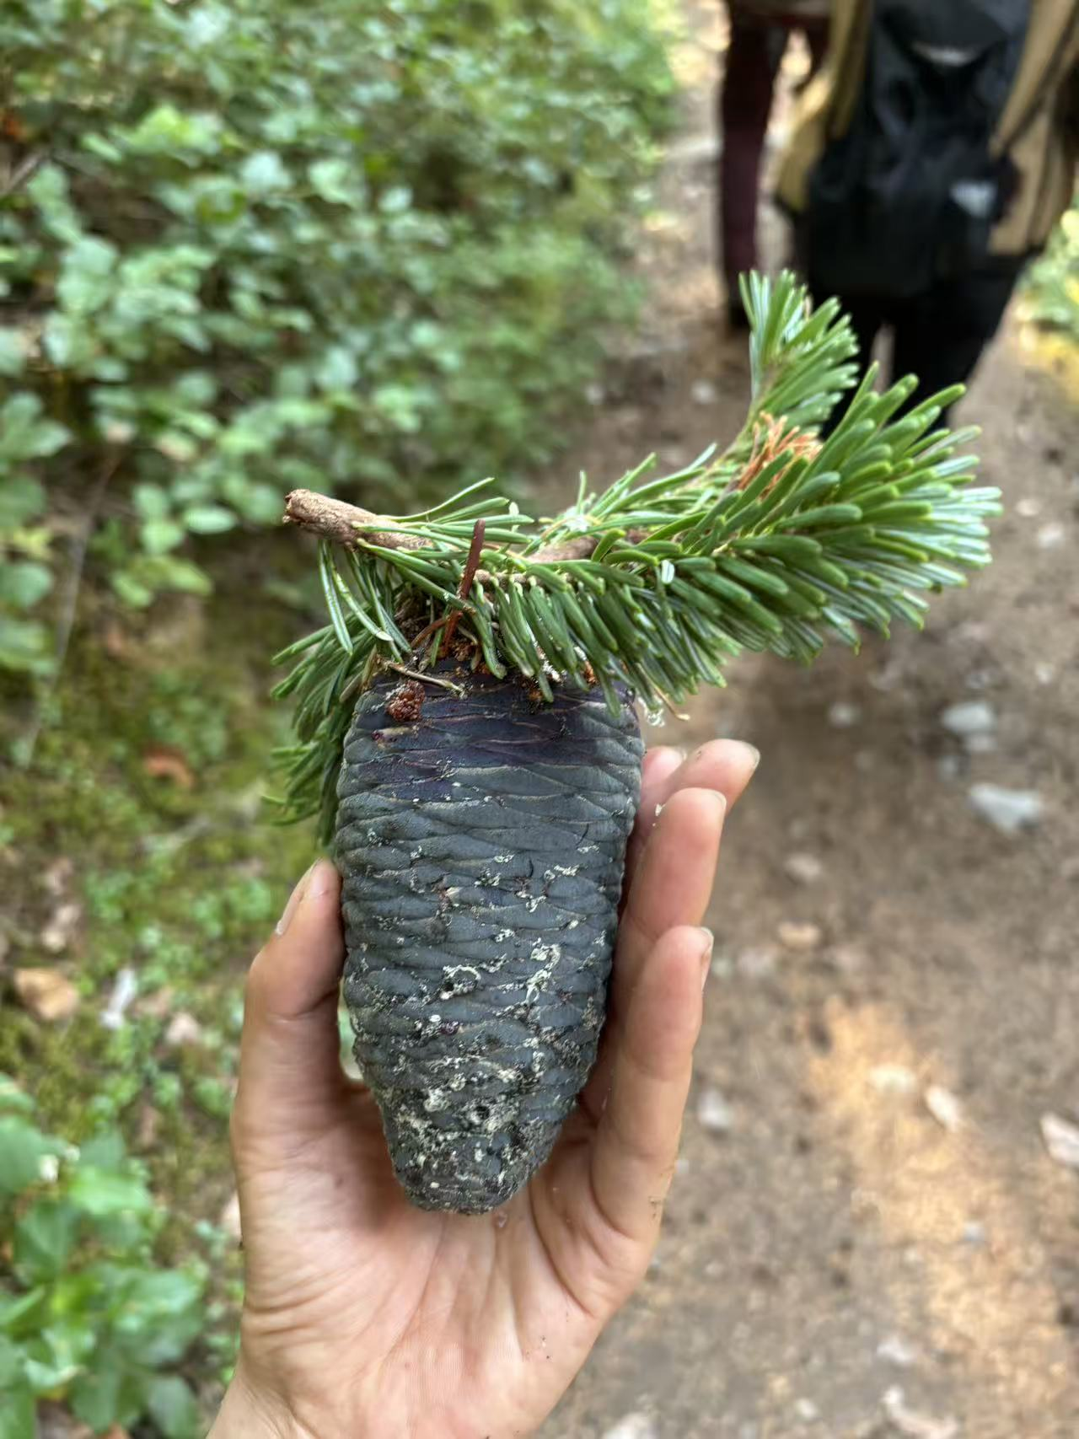

Slide 15
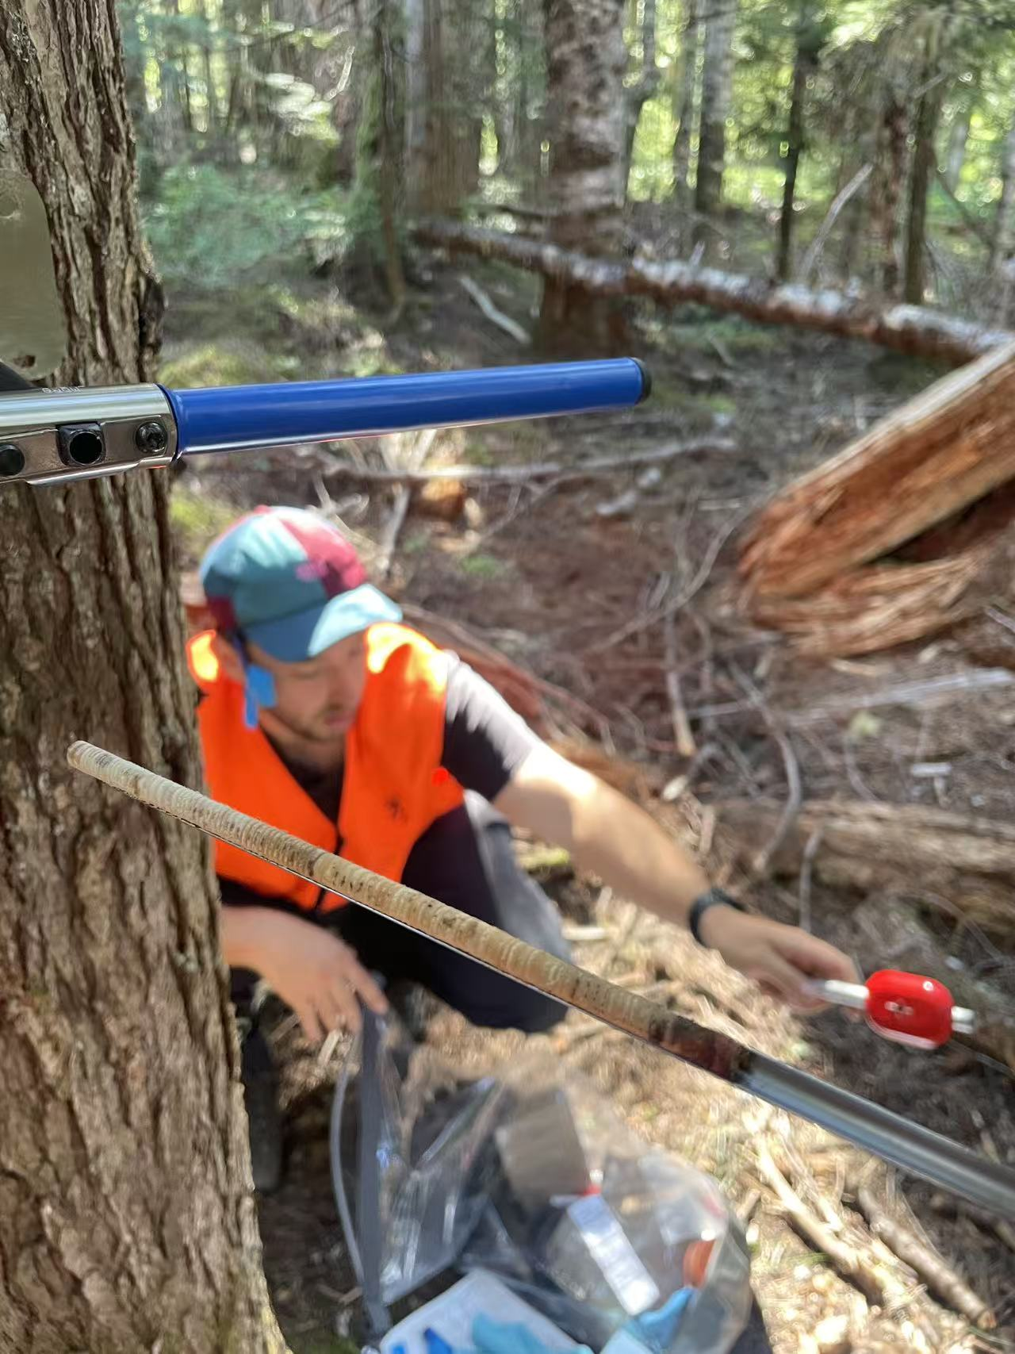
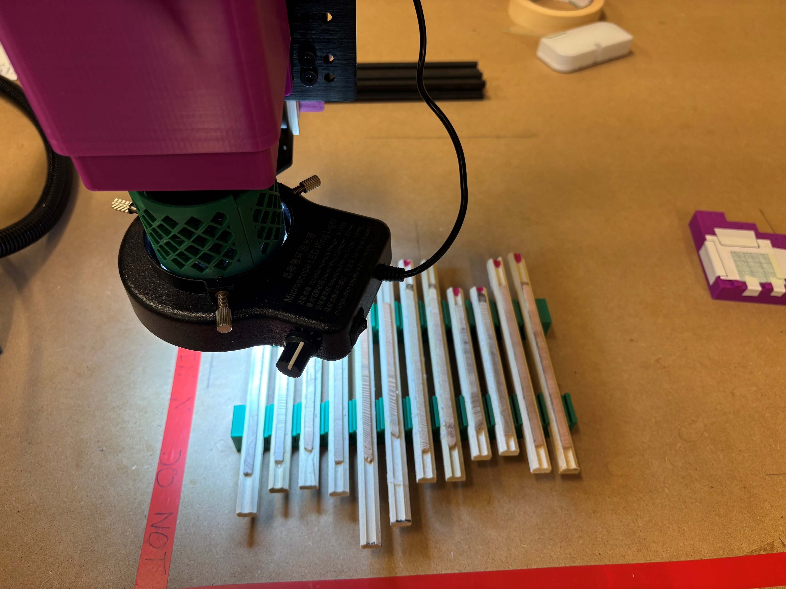
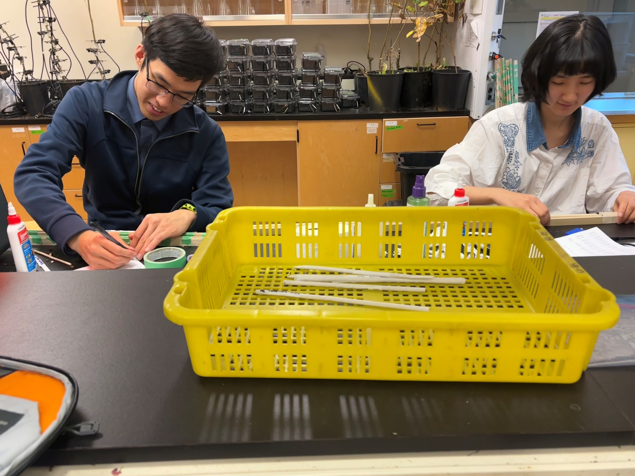



Coring Mounting Sanding Scanning Measuring Cross-dating Analyzing

Slide 16





WorkLearn students: Qingyang Deng, Mark Pan, Colette Bennett, Tess Blajberg, Nolan Meier

Slide 17
Seed_{j,sp,y} ∼ NegBinomial(λ_{j,sp,y}, ϕ)
The modeled seed count (λ_{j,sp,y}) for stand j, species sp, and year y is:
log_{(λj,sp,y)} = α₀ + α_{sp} + α_{j} + β_{1,sp} ・ Growth_{j,sp,y} + β_{2,sp}・ Growth_{j,sp,y−1} + β_{3,sp} ・ Elevation_{j}

